Slide 1
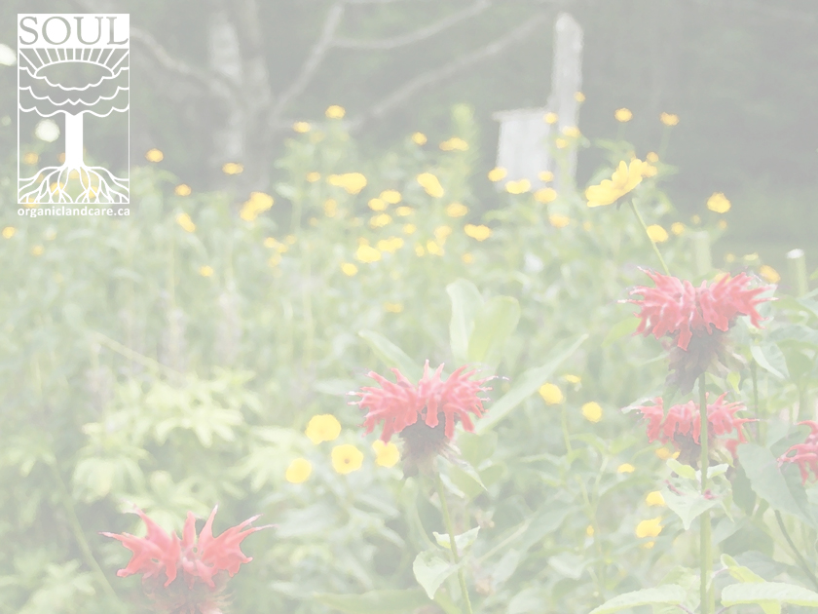
Working from Where We Are
The Role of Horticulture in Cultivating Social and Land Equity
October 8th Learning Session
Presented in Partnership with

Slide 2
Welcome
Thank you for coming together for this discussion
My name is Sundaura Alford Purvis and I’m speaking to you from Ottawa, Ontario, where I live and work on unceded Algonquin lands

Slide 3
The shape of this series
While today will be a presentation, this series is intended to be a conversation, with a pair of gatherings for each of the topics that we’ll be exploring between now and April.
The first of each pair will be a learning session, with a speaker or panel on a specific topic.

Slide 4
The shape of this series
The second will be a gathering following the format of a sharing circle where we will hold space for our experiences and for exploring our reactions and perspectives.
If this group becomes too large for that format, we’ll create another gathering at different time and day and split into smaller circles.
Over the next few months my hope is that we will come to better understand each other and ourselves and begin to form connections that will outlast this series and support each of us as we work toward cultivating more equitable communities.

Slide 5
Today will be an overview
In this session I’ll work to describe an overview of the relationship between land, ecosystem and social equity, and to provide some guidance for those of us who practice horticulture to incorporate practices of equity and decolonization into our work.
While I speak as someone from a primarily White background and from Settler roots, the next few learning sessions in this series will center Black and Indigenous voices.

Slide 6
A few years coming
This series has been building for a while and has come together from a lot of ah-ha moments, personal experiences, frustration and fervent discussions.
(Some of you have been on the receiving end of some of my stream-of-consciousness soliloquies on the topics of sustainability, regeneration, exploitation, responsibility, agency and inspiration. Thank you for lending me your ears, it has really helped).

Slide 7
A few years coming
Weaving all these thoughts and ideas together into a coherent whole has been one of my biggest challenges in putting this session together.
I eventually came to a narrative thread that I think is coherent and weaves together several big issues into something that gardeners will find accessible and practical.
I’m going to follow that narrative from the root up to the flower, admittedly tracing a couple of different branches along the way.

Slide 8
My Roots
My journey started with the wonder of plants, led to a quest for sustainability and eventually brought me to a question of equity, responsibility and relationship.
It started with the magic of a giant squash vine growing from a single seed. I didn’t actually like eating squash at that time, but it didn’t matter, I was hooked.
Over the next few years I checked out all of the gardening books from my small-town library. Multiple times
I learned the names and the nature of the trees, shrubs and most of the wildflowers in the ecosystem where I grew up.
I saved up my allowance for trips to the garden centre
I poured over catalogues and learned to grow perennials, flowers and vegetables (other than squash) from seed

Slide 9
My Horticultural Career
My first job wasn’t babysitting or a paper route, it was gardening.
My second and third jobs were in seasonal garden centres
I took a short trip into architecture and then came back to the horticultural world as a garden centre based landscape designer.
I completed my professional certification in landscape design
I moved on to a design-build landscaping business
I won several landscape-industry Awards of Excellence for my designs
I launched my own design company
I started teaching landscape design at a local college

Slide 10
A Nagging Question
Throughout this journey, I’ve been interested in sustainability. How can the work I do result in an overall positive ecological outcome?
It was a rabbit hole that just kept getting deeper and more complex and I hadn’t even started asking about the social aspects of my work yet.

Slide 11
A Nagging Question
The common targets of questions of sustainability in the horticultural world are lawns and peatmoss but there are many more things that also need to be considered.
Is irrigation of established landscapes ecologicall harmful or helpful?
Mulch is good for the soil, but what about the trees and forests it is extracted from?
Plants are lovely, but it is amazing how many know invasive species are being sold in garden centres to un-suspecting gardeners.
Even native species are often grown in plastic pots and peatmoss-based soil in fossil fuel-heated greenhouses and then shipped far away from the seed populations they originated from.

Slide 12
What about the hard materials?
Mining
Manufacture
Transportation
Waste
What about the materials that are removed from project sites?
Concrete for pavers and retaining walls has a high carbon footprint, what are the alternatives? But rock is also quarried and transported, often long distances.
Can using less be good enough?

Slide 13
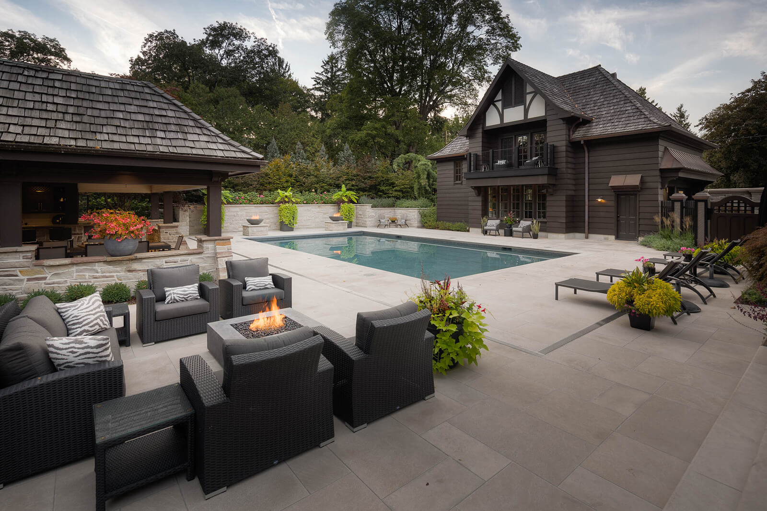
What would sustainable even be?
In an industry where the narrative of what qualifies as excellence is being defined by images like this:
There were very few people willing to even discuss these topics.
“Landscape Ontario Dunington-Grubb Award 2020: Awarded to: Seferian Design Group This award goes to the most outstanding and highest overall scoring project in the various construction categories.”
(image from public Facebook posting. Please clink on image to visit the source)

Slide 14
Working with what I could find
When I found resources and learning opportunities, I pursued them
An Organic Master Gardener course
An Indigenous Seed Seva Mentorship
A Women in Permaculture Design Certificate course
Books on sustainability
Conferences on soil regeneration

Slide 15
I started to notice something:
The concepts and the examples with the most solid foundation, that didn’t rely on dismissal of harms or externalization of costs (human, livestock, ecological, climate etc.) to appear sustainable were all rooted in Indigenous knowledge and relationships.
Not from a single culture or continent, but from people living in direct, long term relationship with the incredibly complex ecosystems they rely on and caring for them with locally adapted technologies, developed from a deep understanding and care-based relationship with place and community.
Indigenous voices, especially a few years ago, were not easy to find in the horticulture world. I’ve since come to understand that there are some very good reasons for this, having a lot to do with horticulture in its current form and practice.
Notes:
The concepts and the examples with the most solid foundation, that didn’t rely on dismissal of harms or externalization of costs (human, livestock, ecological, climate etc.) to appear sustainable were all rooted in Indigenous knowledge and relationships. Not from a single culture or continent, but from people living in direct, long term relationship with the incredibly complex ecosystems they rely on and caring for them with locally adapted technologies, developed from a deep understanding and care-based relationship with place and community.
Indigenous voices, especially a few years ago, were not easy to find in the horticulture world. I’ve since come to understand that there are some very good reasons for this, having a lot to do with horticulture in its current form and practice.

Slide 16
I was able to find some resources:
Plants Have So Much to Give Us, All We Have to Do Is Ask, was the first book I encountered that, rather than being about how Indigenous people ‘used’ plants, was by an Indigenous, Anishinaabe, author on relationships with plants. Through this book Mary Siisip Geniusz weaves the lives of the plants and the lives of the people together through a beautiful blend of teaching stories and practical and technical information.
She describes a way of being in relationship with the botanical world that left me saying ‘Yes, this!’ and looking for more.
Notes:
I was able to find some resources though. Plants Have So Much to Give Us, All We Have to Do Is Ask, was the first book I encountered that, rather than being about how Indigenous people ‘used’ plants, was by an Indigenous, Anishinaabe, author on relationships with plants. Through this book Mary Siisip Geniusz weaves the lives of the plants and the lives of the people together through a beautiful blend of teaching stories and practical and technical information.
She describes a way of being in relationship with the botanical world that left me saying ‘Yes, this!’ and looking for more.

Slide 17
Influential voices
Braiding Sweetgrass was next, the audiobook is amazing, Robin Wall Kimmerer’s voice draws you in as she shares her stories of botanical and human relationships and interactions. Through a series of narratives, she weaves painful history and difficult lessons with grace while teaching of relationship and responsibility, of joyful reciprocity, rather than the ‘use’ of plants.
Once again, Yes, this!

Slide 18
How to connect it with my day to day
What would a reciprocal ecosystem relationship look like for a landscape designer?
When the busy season arrives, falling back on years of patterns in designing spaces with familiar tools and ways of thinking can feel like the only way to get through everything.
A tired brain does not like to work in unfamiliar ways.
I eventually decided that I needed some time and space to redesign my ways of thinking about plants and landscapes. Thirty years of patterns take some work to unweave.

Slide 19
A summer with the plants
Taking on a teaching position had opened up the opportunity for me to take time away from my design work for a summer
For the first time in many years, I wasn’t racing from project to project during the growing season
In addition to getting my hands back into the soil, I worked at building some new paths for my thoughts to follow.
The ways that we think are formed by the thoughts and ideas that flow through our minds. When I want to change patterns, I seek out different perspectives and ideas to feed my brain.
I found books by Anishinaabe and Haudenosaunee authors, two Indigenous cultural and language groups that have millennia long relationships with the lands and ecosystems I live in and work with.

Slide 20
I tried out new-to-me practices
I looked for events that included or centered Indigenous speakers and teachers.
I followed and Indigenous Seed Seva course that explored relationship and responsibility toward our seed relatives and moving back into rhythms guided by natural cycles, rather than clocks and calendars.

Slide 21
Was I just taking more?
As I learned, I began to wonder, was gathering all this knowledge just another thing that I was taking from Indigenous people? Colonization took the land, took the children, buried cultures. Now, as we begin to face the predictable outcomes of taking more from land and ecosystems than they can bear, we scramble to gather Indigenous knowledge, hoping that it will save us from our folly.
Socioeconomic structures make conferences, events and information resources more available to me than to many of the Indigenous people whose cultures these teachings originate from.

Slide 22
Did I have anything to offer in return?
Compounding this concern was the reality that my work was only accessible to people of a certain socioeconomic situation – If they don’t have authority to make decisions about land (i.e. possess the deed) they have no need for a design for that land, much less a desire for me to impose aesthetic creations onto existing living systems
What, as someone with a lifetime in horticulture, did I even have to offer?

Slide 23
And then it clicked:
When speaking on land relationships and food sovereignty, Joce Two Crows described the challenges that Indigenous peoples in urban spaces have in accessing land for ceremony, gathering medicines and growing food.
More than half of the Indigenous people who live within the borders of what is currently Canada live in urban settings but have little or no local access to green spaces.
Horticulture, in one way or another, influences how land is cared for and shaped in almost all urban green spaces. We set the expectations, provide the materials, services, plants and products that flow into those spaces.

Slide 24
All Work
Years ago, I came across the phrase ‘All design is ecological design – one way or another’. It resonated for me. Whether or not we intend for our decisions to affect the health of the ecosystems we work in and draw from, they do. One way or another, they do.
Now I’m beginning to see that all work is social work – one way or another. We are either upholding and reinforcing existing systems, or altering them in some way.

Slide 25
Landscaping is in a precarious position
The existing system of Landscaping, as an industry, is in a very precarious position.
As with most types of work and aspects of society at the moment, disruption is on the horizon.
As the climate continues to shift, extreme rainfall will necessitate more permeable cities, with far less paving and concrete (the legislation around this is already waiting in the wings in Ontario).
Increasingly extreme drought conditions will lead to limits on the use of water on ornamental landscapes.
Loss of critical species will put pressure on the sale of invasive plants and on exotic and monoculture landscapes.

Slide 26
Landscaping is in a precarious position
Restrictions on nitrous-oxide, an extremely potent greenhouse gas, will lead to the limiting, or elimination, of the use of non-organic source nitrogen fertilizers in ornamental landscapes.
Phosphorous fertilizers are already facing restrictions in many places due to runoff and water contamination.
The carbon release from mining peat bogs and extracting forestry products will drive up costs or place restrictions on their consumption for ornamental landscapes,
Legal protections for agricultural soils will make buying a load of earth a much more expensive undertaking, if it is an option at all.

Slide 27
Change is Coming
While landscaping faces those climate related challenges, the places we import much of our fresh food from are coming under more extreme climate pressures (California fires, salination of Florida’s groundwater as sea level rises, depletion of the aquafers in the middle of this continent). As this year has shown, when worried, we plant food (we should also compost, but not everyone is there yet).
Change is coming. The work of shaping land to picture perfect form and colour, with clean lines and low maintenance beds of non-native species that don’t get chewed on by many native beings is going to go away in the next couple of decades as the world changes.

Slide 28
Gardening is coming back
At the same time, gardening, as an activity, is experiencing a resurgence.
More people are reconnecting with the plants and the systems that surround and feed us.
Growing food is a way to regain agency and connection when the world as we know it is becoming uncertain.
As this year has shown, when we don’t feel safe, we grow food. But opportunity to grow food is not equally available.

Slide 29
Unequal Access
Access to greenspace, to the land to grow food, is far from consistent across socioeconomic and race spectrums. Those with the fewest economic resources to ride out rising food costs have the least opportunity to grow food for themselves.

Slide 30
A History of Trauma
This is partially rooted in laws and social structures that permitted and enforced the exploitation of Black and Indigenous farmers.
The history of sharecropping in the United States is fairly widely known, if not in detail, at least that this system once existed.
In Canada, the history of the permit system, which prohibited Indigenous communities from selling any of their agricultural products or even purchasing farming equipment without explicit permission from the local Indian agent is less well known.
The trauma of these and other exploitations succeeded in driving a wedge between the people who were forced to live through them and their relationship with working with the soil to grow food and make a livelihood.

Slide 31
Resurgence
With the resurgence and reclamation of Black and Indigenous cultures, and increasing demands for food sovereignty and land back, more and more marginalized people are breaking through shaming narratives around agricultural and land-based work.
In returning to land-based relationships with plants, food and medicine, these same people are also bringing back practices that come from different roots than the colonial/industrial agriculture that currently dominates the majority or arable land on Turtle Island.
The principals that are often framed as originating in Permaculture, Biodynamics or Organics are almost all drawn from Indigenous knowledge and practices on various continents, although many have been removed from their relationship with their original ecosystem or culture.

Slide 32
Cultivating something different
At places like Soul Fire Farm and Sylvanaqua, these practices of cultivation are laying the foundation for restoring ecological health, creating equitable access to food and land and practicing alternative forms of livelihood and ownership structures.
The contrast between the work being done by BIPOC (Black Indigenous, People Of Colour) farmers and cooperatives and the conventional agricultural system that currently holds the majority of land, highlight the reality that, too often, those of us with the most power to make decisions about land are also the most generations from living in rooted, reciprocal relationship with land, of depending directly on the health and vitality of the land for our own health and vitality.

Slide 33
A flawed foundation
Conventional agricultural and horticultural practices treat land and the ecosystems that exist on that land as property that can be altered in any way we choose, whether for profit or whim.
(In her book Gathering Moss, Robin Wall Kimmerer explores in the chapter ‘The Owner’)
The land and ecosystem are not treated as having inherent rights of existence.
The outcomes of this type of relationship and exploitative practices are becoming increasingly visible.

Slide 34
Extractive solutions
The California, Oregon and Washington fires, like the Australia fires earlier this year, have many people saying that we need to return to Indigenous burning practices. What I haven’t seen much of are serious suggestions that the land needs to be returned entirely to Indigenous management. As if the burning can simply be extracted from Indigenous practices; separated out from the complex systems that it exists within and inserted into colonial land exploitation and still be effective.
And even if this was possible, what would be owed for the knowledge of the burning practices? They were developed over millennia. What is the value of that kind of R&D? Something like the value of corn and potatoes, two other outcomes of eons of care and relationship that have been commodified?

Slide 35
Authority to decide
If we try to save ourselves by extracting and commodifying Indigenous knowledge, we are building on the same framework of exploitation that the land is currently suffering under.
We know that the knowledge and practices that we need to help heal the planet are held by people who have often been pushed to the margins.
Indigenous peoples hold 25 percent of the world's land surface and steward about 80 percent of the remaining global biodiversity.
Black farmers who have historically been the backbone of the American agricultural sector, making up 1/5 of farmers and ¼ of ranch hands a century ago and having a history of a high degree of agricultural success now only hold 0.52% of agricultural land.
Those of us who currently hold the majority of the power to make decisions about land, plants and ecosystems need to relearn the practice of reciprocal, regenerative relationship with the ecosystems we are a part of.

Slide 36
Fractured solutions = Fractured future
But most of all, we need to take a good hard look at the Colonial narrative that states that land and ecosystems are to be dominated and formed for our profit and comfort and how a certain amount of exploitation is just how things work.
If we don’t question the world view that led us to our current situation, if we adopt ‘regenerative’ grazing, while still excluding the native grazers and predators from the land, or Indigenous burn traditions while continuing to cut swaths through the forests, we are setting ourselves and global ecosystems up for further collapse.
Rather than bringing healing and regeneration, we are manipulating systems to extend their ‘productive life’ without getting to the underlying issues.
The change we need to cultivate is in the relationship that we base our decisions and actions on, rather than simply adopting specific practices.

Slide 37
It is in Horticulture too
Exploitative relationships don’t only exit in agricultural or rural spaces. The large nurseries that grow the majority of the plants for the horticulture industry rely on the same seasonal worker programs as the agricultural sector. The programs that have recently become the focus of media attention due to the spread of Covid through the cramped conditions of the workspaces and the employer provided housing but that also have deeper issues around worker mobility, physical safety and pay rates.
The history of reliance on exploited labour underlies the colonial history of this continent. It continues to be the basis of the food system and the largescale/wholesale nursery trade.

Slide 38
Where the plants come from
Issues around exploitation in horticulture aren’t restricted to labour and the extraction of materials from the earth and ecosystems.
Bio-colonialism and bio-piracy, the taking of plants from place and relationship, without permission from, or credit or compensation for the people who have tended the ecosystems being ‘explored’ has a deep history in agriculture and is now beginning to recognized in the horticultural world.

Slide 39
The Work That Comes First
At the core of Indigenous teachings around land and plants is the concept that relationships are more important than specific techniques, plants or products. The same applies to human systems and communities.
Whether we are talking about equity or reconciliation, the work that comes first is the cultivation of relationship.

Slide 40
Learning the practice of relationship
Those of us working from Settler backgrounds often don’t start off with good tools for cultivating strong, flexible, diverse, reciprocal relationships. We generally start off with the tools that create the social and ecological disconnection that we are hoping to fix.
To be in relationship is to be influenced by those we are in relationship with.
Cultivating relationships isn’t a simple matter of inviting groups that have historically been excluded into our spaces. Spaces need to evolve into something that is inclusive of everyone and reflects complex diversity.
Sometimes creating equity also means ensuring that resources are available for groups to create their own spaces.

Slide 41
The work of unpacking
The story of the last few centuries of history on Turtle Island is one of genocide, exploitation, displacement and erasure.
The severing of relationship to land, ecosystems and community is also a trauma that most of us have in our family histories within the last few generations.
We are all woven into this cloth in a variety of roles and unpacking that history can be painful.
Unpacking how that history is expressed and experienced in the present is often disturbing and traumatizing.
Many of us who have become aware of these realities well into our adult lives find ourselves ill prepared, without good tool kits for working through the grief, anger, dissonance and pain of realizing that our world isn’t what we were taught it was.

Slide 42
Support
It is also difficult to succeed in the work of unpacking that experience without a network of others on similar journeys.
This is part of the purpose of the discussion sessions. To provide space to work through the mucky stuff so we have a better chance of succeeding in the important work of weaving new patterns and setting new foundations for our relationship with land, ecosystem and community.

Slide 43
Dealing With Discomfort
When we start to try to make connections across social, race or economic divides we sometimes find that entering a space where the power structures are inverted from what many of us are used to can be disorienting.
A common reaction is to defend our right to be in a space by proving that we are knowledgeable or ‘woke’. That, despite settler roots or light skin, we really do ‘belong’.
These are behaviours and reactions learned from coping within the types of power and social structures we are often trying to escape from when we go looking for alternatives to the currently dominant culture.

Slide 44
Doing our own work
Practice accepting a place at the back or at the edge.
Listen and learn.
Keep showing up.
Hold some internal space for information or ideas that are jarring. There is no need to make snap judgements about new information that conflicts with our personal experience or perspective.
Don’t skip the foundational work. Urgency, changing things ‘Right Now!’ can feel sooo important when so many things are going so wrong but if changes are built on unsustainable patterns, they are almost always set up to fail in the long run.

Slide 45
Doing the slow work
Rushing is also when we tend to take the most shortcuts and cause the most collateral harms because of lack of understanding of the systems we are rushing into.
Changing the world is sometimes a matter of what to say or what action to take. Other times it is a question of listening and making space for others to act without pressures to fit within existing structures, expectations or norms.

Slide 46
Not adding to the work
When cultivating understanding, asking is good for specifics, why or how about a place, a project, an action.
For generalities, especially ones that would put the work of explaining structural issues or ‘proving’ that something is harmful or racist on to the person experiencing that harm, remember that there is a universe of information available on the nearest screen.

Slide 47
Where is this from?
Be wary of those offering ‘Indigenous’ teachings if they do not also share the lineage of what they are selling. Teachings are easily distorted, intentionally or otherwise, when severed from their roots. The understanding of who has the right to hold or share knowledge and stories can be quite different in different cultures.
A vast over simplification, but one I’ve found helpful to keep in mind, is that anything created by nature, such as land, air, water, plants, seeds, animals, humans etc. are beings unto themselves and are not something that can be owned. Anything created by humans, art, ideas, knowledge, songs, some (not all) stories can be held in the possession of the people who created them and are not free to be copied or shared without explicit permission. Most Indigenous teachers will share the story of how they came to hold their teachings and on what basis they are sharing them.

Slide 48
Our gifts are our responsibility
When the times does come for action, we have the most capacity to create change within our own sphere of influence and expertise.
By shifting from patterns of colonization and domination in human relationship with the landscape we can create patterns of decolonization that flow into other aspects of our lives. By practicing reciprocity and care in our work, we create physical examples of decolonization in the urban landscapes where the majority of people now spend the majority of our lives.

Slide 49
Practice Gratitude
The action of practicing gratitude is a reciprocal gift often spoken of by Indigenous teachers. Gratitude is a gift that changes both the recipient and the giver.
We value and protect what we are grateful for
When we are feeling gratitude, we are less likely to be frantically seeking the next thing
Gratitude helps us recognize when we have enough and don’t need any more.
The Words Before All Else are a practice of gratitude that the Hausenosaunee has gifted to the world

Slide 50
Offer Attention
Attention is also a gift that changes the giver. Take time to get to know the life that you interact with.
Where do your plants come from?
Both the individuals and their ancestors.
Who did they live in relationship with before they came to your garden?
Do any of those relationships continue to exist within their new home?
Can you help to restore them?
Who was historically in relationship with the land that you are working with? The people, the birds, the animal yes, but also the plants and the tiny beings that live in complex relationships with them?
Are they living and thriving now?
If they aren’t, can you help to change that?
Can you collaborate with the plants to nurture a thriving ecosystem?

Slide 51
Question the assumptions
Most of us have inherited a system that, for generation upon generation, has relied on expansion and extraction and we are surrounded by the persistent reinforcement of the narrative that this is necessary. That it is part of what it is to be human.
Daniel Quinn describes the creation of this narrative as the great forgetting
The pattern of endless expansion is a cultural creation, something that Jack D. Forbes describes as the Wetiko disease, a contagion of endless consumption that eats all life.
There are many ways of being that are not built up off of this foundation.

Slide 52
Gardening as action
Gardening can be the physical act of colonization through the removal of native species and soil and their replacement with alternatives that are tractable, familiar, managed, maintained, constrained, tidied, and predictable.
Gardening can also be a radical act of decolonization and cultivation of relationship.
The colonial version of gardening is what most of us are introduced to when we first experience the urge to weave even a small connection to plants and land back into our lives.

Slide 53
Regenerating garden relationships
Many of us have never had a chance to learn what a healthy and thriving system looks, sounds and feels like. We are taught that a well ‘cared’ for garden is one that is neat and tidy.
We don’t see that relationships are missing because we haven’t seen or experienced then. We don’t know that there is anything to miss.
Those of us already working in horticulture have the opportunity to change this.

Slide 54
Gardening as Reciprocity
I’ve been moving more and more toward planting and nurturing native species. Not from a racial purity standpoint, which can be surprisingly common in certain native species circles, but because I don’t know, the whole of science doesn’t know, enough about the relationships that plants form with the macro and micro biome, to be confident that a species from far away can form strong, reciprocal relationships with the life that can only live in the space that I am working with.
I want to do what I can, in my own small way, to support that life. To practice reciprocity with the systems that have supported my life and livelihood.

Slide 55
Add life, rather than removing it
There are a lot of holes in the ecosystems of most urban landscapes. Just like cultivating a healthy relationship with food is less about removing specific items than it is about focusing on adding more whole and healthy foods, decolonizing the landscape is less about ripping out the introduced species than it is about filling all of the spaces in our minimized systems with life supporting species.
You aren’t buying more plants; you are decolonizing the landscape

Slide 56
A common justification
A common reason offered for planting non-native species is that native species often don’t thrive in urban conditions.
Rarely is the responsibility for their failure to thrive placed on what went into creating those conditions.
Even less common is making a real effort to restore the health of urban spaces to the point that a diversity of native species can thrive within them.

Slide 57
It isn’t just in the garden
The same can be said about human systems. The creation of reconciliation and equity isn’t (just) about inviting previously excluded people into existing spaces.
Systems, structures and ‘normal’ are built and defined by the people and cultures that occupy a space. The structures that surround us are often so familiar that they can assume a ‘neutral’ state in our minds, becoming invisible unless we actively look for and question them, or they are pointed out to us.

Slide 58
Seeing the Background
In David Foster Wallace’s now famous commencement speech he shared the parable
There are these two young fish swimming along, and they happen to meet an older fish swimming the other way, who nods at them and says, “Morning, boys. How’s the water?” And the two young fish swim on for a bit, and then eventually one of them looks over at the other and goes, “What the hell is water?”
We don’t always see what our space is made up of because it is so familiar

Slide 59
Is it the space?
Simply opening up a space, without consideration for whether that space is in itself capable of being inclusive leads to other issues and conflicts:
“We gave them a chance but they can’t hack the work”
“They just aren’t a good fit for the team.”
“We let them in and they still aren’t happy.”
“Now they expect us to change to make them happy and comfortable and ‘feel safe’!”

Slide 60
Don’t wait to be asked
Rather than focusing on individual accommodations, look for what is making the space unwelcoming in the first place. Structures, behaviours, conflicting values and priorities?
What are the barriers that are preventing people from creating their own spaces that meet their own needs?

Slide 61
Can you find the water?
When we fit well into the existing culture, don’t put the work of questioning the culture on others.
Look for the ‘water’.
There is no shortage of information and material available about equity and inclusion, there are articles, books videos and published studies about race, culture, allyship and bias easily available online and through the public library system.
Even better, buy books and take paid courses by authors and teachers who are Indigenous, Black or People of Colour.

Slide 62
Our choices extend beyond our spaces
When it comes to the physical aspects of work, especially when bringing products or materials into a space, pause and consider:
Where did it come from and how it was grown, produced or created?
What happens with it once it no longer fills the role it is being placed into?
Who will be affected by this?

Slide 63
Do our work first
We so often want to rush in and fix problems for other people and in other spaces when we see them, often causing more harm in the long run.
The big problems are supported by small patterns.
They can be undermined by changing those same small patterns.
In the book Emergent Strategy, adrienne maree brown describes systems as being fractal. If we change the small patterns, new large patterns will naturally emerge.

Slide 64
Practicing in the Garden
Gardens can be a great space to learn to notice the joyful, vibrant, thriving complexity that comes of many different beings living and growing together.
They can also be a place to practice responsiveness, adaptation, patience, joy and gratitude.
It is valuable to work on changing patterns of rushing, of not noticing, of interruptions in relationship that make bonds fragile. Purchasing new seed every year breaks the connection between a successful season for the gardener and a successful season for the plants.

Slide 65
Practicing Reciprocity
When we honor the connection between the plants caring for us and our caring for the plants, we cultivate a relationship.
I’ve found that practicing a relationship of care with the garden and the plants has added a new facet to my gardening. Plants live to grow and share seeds.
One of the gifts I can offer them in return for all of the gifts that they share with me is to help care for and distribute their seeds.
Fall cleanup has been replaced with fall gathering.
Pouring over catalogues in January has been replaced with sorting, cleaning and labeling packets of seeds to share.
Other gardeners, on receiving seeds from the plants I care for, are also quite happy with this development.

Slide 66
Practice care within our existing circle
Don’t rush out and buy ‘Indigenous’ seeds.
A good comparison of this would be when ‘good white families’ adopted ‘Indian’ children as a charitable act.
Many Indigenous communities are only now reuniting with their seed relatives, following centuries of disruption and displacement.

Slide 67
Respecting relationships
Businesses that promote ‘Indigenous’ seeds and ‘traditional’ medicine plants, often without naming the community they come from or the people who have carried then, like Baker Creek Heirloom Seeds and Richters Herbs have very different reputations in Indigenous seed stewarding communities than in the wider horticultural world.
Rather than kidnapping more plant relatives, we can practice by caring for the seeds we already hold or that we have forgotten to care for in the generations between our own Indigenous or peasant roots and our current lives.

Slide 68
Some thoughts to close with
We are inheritors of a system of colonization but we do not need to be the defenders of that system.
To work toward equity, actively seek out the voices of those who have been pushed to the margins.
Bring curiosity
Practice listening
Offer attention

Slide 69
Stick with it
The process of unpacking long-held perceptions will be an unfamiliar work for many of us. We’ll stumble and sometimes feel disoriented and anxious; outside of the familiar and comfortable. Acknowledge this, hold some space for the uncomfortable and the scarry.
Expect to screw up, accept the feedback when it happens, do better next time
Keep showing up. Far too often when times get tough or change takes too long, allies fade away. If you want to be seen as reliable, trustworthy and willing to do the work, be reliable, trustworthy and do the work.

Slide 70
Expect to Grieve
At some point you’ll likely discover that something or someone that you love or respect has an ugly side or an ugly history. Your personal experience may not reflect this because your position and perspective is different. This doesn’t mean that someone with a different experience or perspective is wrong, a liar or needs to stop pointing out difficult and uncomfortable things. It isn’t the responsibility of the victim or survivor to help us work through our grief or anger. That is the role of our support network and part of the reason that cultivating this network is important.
Take the time and space for grieving beliefs or relationships.

Slide 71
Really Practice
Changing culture isn’t something that we’ll achieve over night.
It isn’t even a destination; it is a journey.
A cycle of growth and rest, of pushing through and allowing space.
Of gentle persistence.

Slide 72
Rest
Rest when needed. Burnout culture is another pattern of exploitation, one many of us have internalized.
Simply practicing joy and gratitude for simple things and the successes of other beings can be a decolonial and radical act, one that heals inside and outside

Slide 73
Nurture
Get to know and nurture more plants. Work with them to nurture the soil and ecosystem.
Get to know and nurture more people. Work with them to nurture community.
Share.
Celebrate.
Repeat.

Slide 74
Thank You
Presented in Partnership with

